Slide 1




IMPACT OF ELECTRICAL GENERATION CONDITIONS ON THE ENVIRONMENT
Choy Jee Hung Caleb p2341475

Slide 2
Table of contents
01.
02.
03.
Problem
Statement & Our Aim
Nature of the
datasets
Analysis of the datasets
04.
05.
06.
Transforming of the datasets
Making Predictions
Conclusion

Slide 3

Problem Statement
Does an increase in electricity generation correlate with negative environmental impacts such as the increase of air pollution levels (PSI) and the climate change such as temperature in Singapore?
Understanding the connections between electricity generation, air quality, and climate changes is crucial for informed decision-making in potential impacts and aiding in decision-making for energy resource planning and management.
This analysis aims to provide insights into how changes in electricity generation may impact air pollution and climate, with potential consequences for the future of our environment.
By understanding the relationships between electricity generation, air quality, and climate, stakeholders can develop proactive strategies to mitigate potential environmental risks and enhance overall environmental resilience.

Slide 4



NATURE OF THE DATASETS
TOTAL OF 3 DATASETS

Slide 5


Electricity generation dataset
The dataset captures electricity generation within Singapore over multiple months from year 1975 to year 2023.
Columns of the dataset:
Data Series | The months recorded in the format YYYY-Month
Electricity Generation (Gigawatt Hours) | The amount of electricity generated in gigawatt/hour
Data Peculiarities
Seasonal variations: Observe fluctuations in electrical across different months. Such as increasing as the months go by.
Missing values: There is missing values found in several months.

Slide 6
Historical 24-hr PSI dataset
The dataset captures an overview of the hourly 24-hr PSI daily across different regions in Singapore from year 2014 to year 2023.
Columns of the dataset:
24-hr_psi | Recorded in DD/MM/YYYY format with the hourly time
Regions | There are 5 columns to represent each region in Singapore (North, South, East, West, Central)
Data Peculiarities
PSI range: Note the PSI range throughout the day. There is generally not much change. However, the PSI range across weeks and even months vary significantly.

Slide 7
Surface Air Temperature Monthly Mean dataset
The dataset captures an overview of the monthly mean surface air temperature in Singapore from year 1982 to year 2023.
Columns of the dataset:
Month | Recorded in YYYY-MM format
mean_temp | Monthly mean temperature of the surface in celcius
Data Peculiarities
Seasonal variations: Observe fluctuations in surface temperature across different months.
Extreme values: Note the significantly high surface temperature in June which is normally associated with Summer and lower temperature in Dec which is normally associated with Winter.

Slide 8


ANALYSIS OF THE DATASETS
3 datasets in total

Slide 9
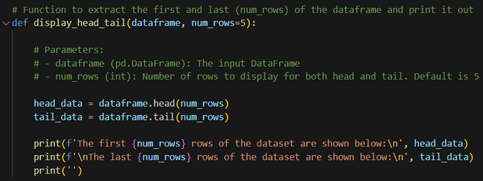
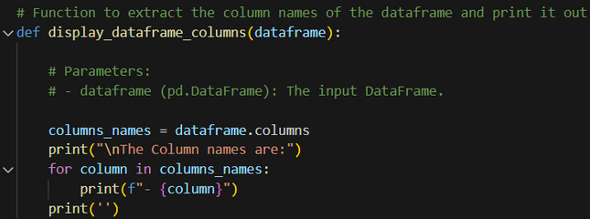
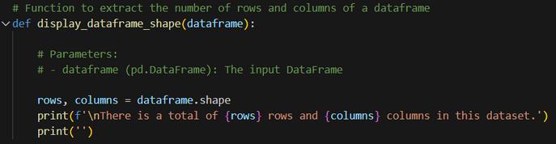
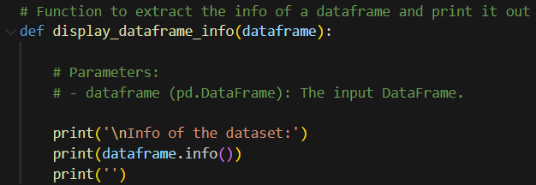
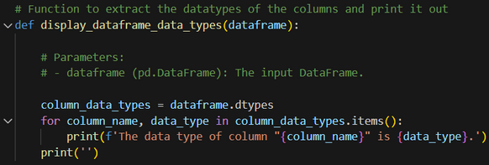
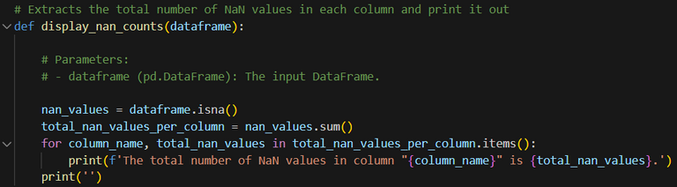
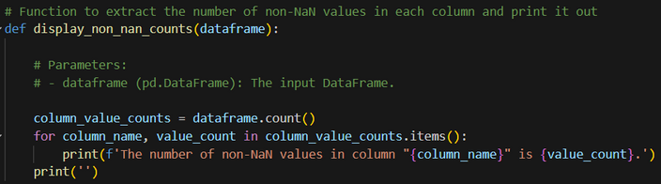

Code used for analysis of the datasets
df.head() and df.tail(): the first/last number of rows
df.columns: Describe DataFrame column
df.shape: Returns (rows, columns)
df.dtypes: Describe the Data types
df.info(): Info on DataFrame
df.isna() and df.sum(): Checks if its a NaN value and sums up the total
df.count(): Returns number of non-NA values

Slide 10
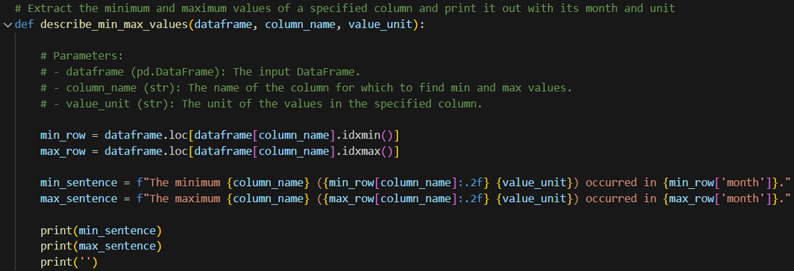
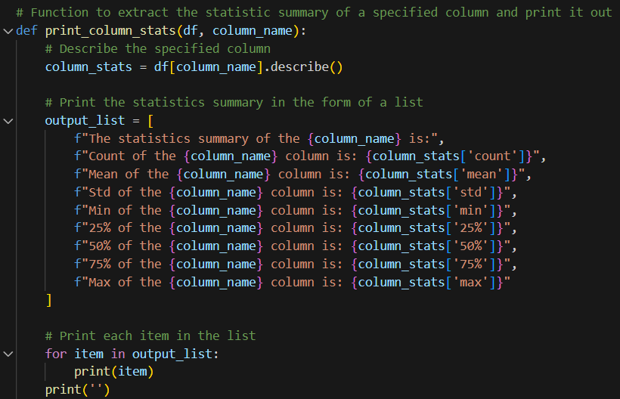
Code used for analysis of the datasets
df.idxmin(), df.idxmax(): Minimum / Maximum Index Value
df.describe: Summary Statistics
df.info(): Info on DataFrame

Slide 11
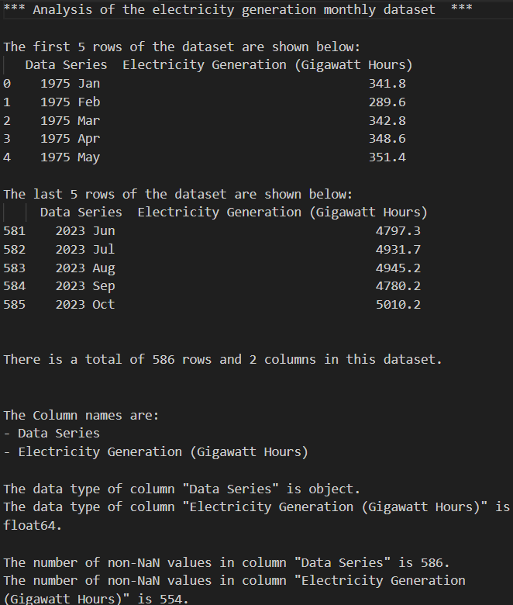
Electricity generation dataset
From analyzing the original dataset:
Time measurement of the dataset is in YYYY-month
The range of the dataset is from 1975-Jan to 2023-Oct.
There is 586 rows and 2 columns present.
The column names are Data Series and Electricity Generation (Gigawatt Hours)
The datatypes are object and float64 respectively.
We can see that there is Nan values from the Electricity Generation Column as there is only 554 NaN out of the total 586 rows that should be present.

Slide 12
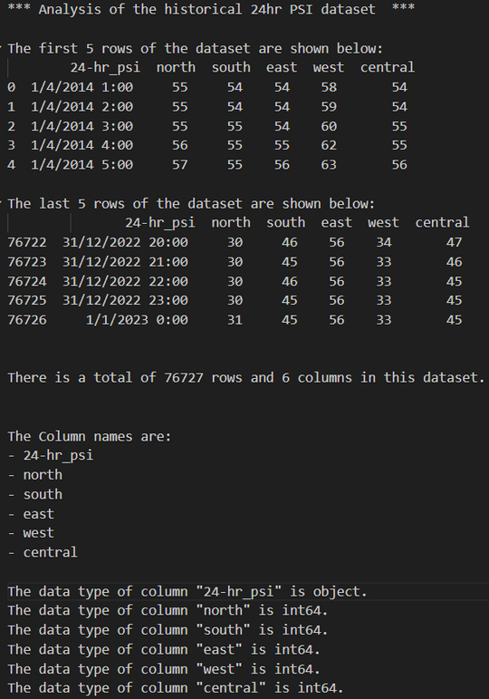
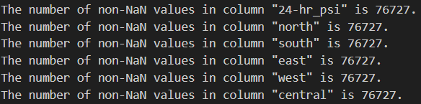
Electricity generation dataset
From analyzing the original dataset:
Time measurement of the dataset is in DD/MM/YYYY with the hourly time format
The range of the dataset is from 1/4/2014 1:00 to 1/1/2023 0:00 .
There is 76727 rows and 6 columns present.
The column names are 24_hr_psi, north, south, east, west, and central.
The datatypes are object for 24_hr_psi and int64 for the rest.
We can see that there is no Nan values present in the dataset.

Slide 13
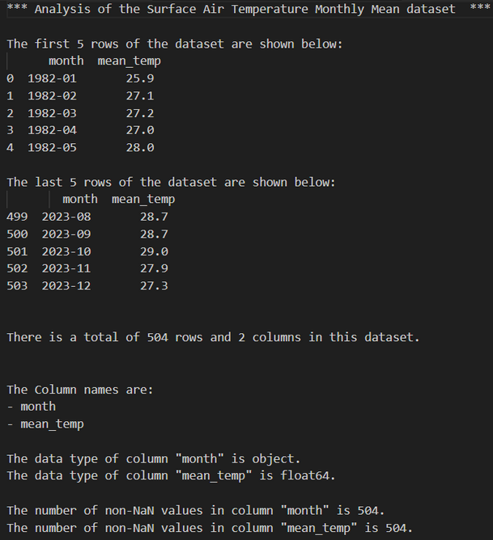
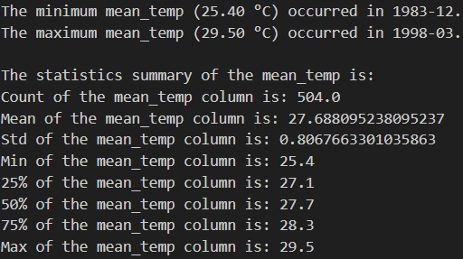
Surface Air Temperature - Monthly Mean Dataset
From analyzing the original dataset:
Time measurement of the dataset is in month.
The range of the dataset is from the 1982-01 to 2023-12.
There is 501 rows and 2 columns present.
The column names are month and mean_temp.
The datatypes are object and float64 for month and mean_temp respectively.
There is no NaN values present in the dataset
From analyzing the original dataset:
Minimum-value is 25.40°C in year 1983-12.
Maximum is 29.50°C in year 1998-03.
The statistics summary of the mean_temp can be found as shown on the left.

Slide 14
What did we find out from analysis?
From analyzing the original datasets:
The Electricity Generation Monthly dataset:
Date format is incorrect (YYYY-month) and column name is not clear (Data Series)
Has missing values in its columns (Electricity Generation)
Subset the date range to match others.
Historical 24hr PSI dataset:
Date format is incorrect (Hourly data) as we want in months.
PSI is by regions and cannot represent the average PSI for the whole of Singapore.
Surface Air Temperature Monthly Mean dataset:
See below
For all datasets:
We require the month column to be common in all datasets to apply linear analysis.
Dtype of months is incorrect, needs to be Period[M]
Subset the date range to match.

Slide 15


TRANSFORMING THE DATA

Slide 16
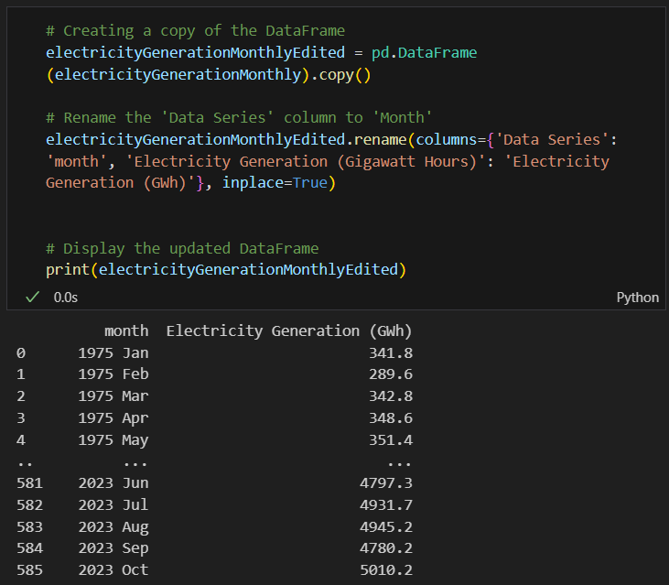
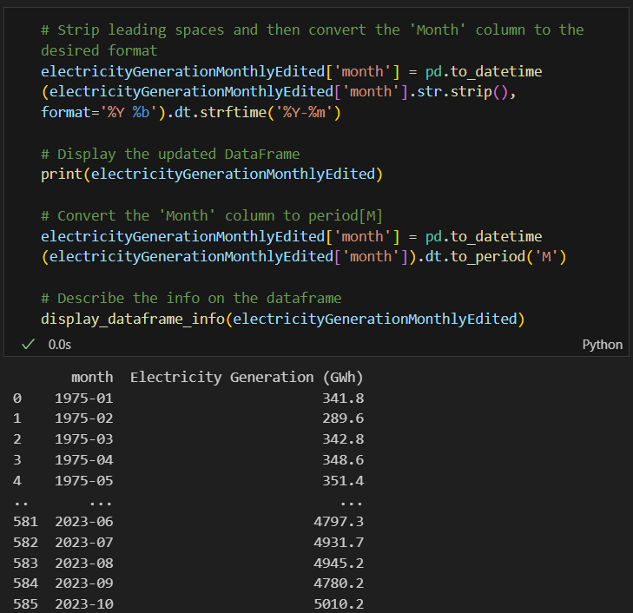
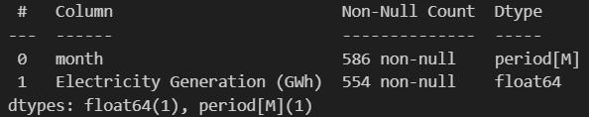
Electricity generation dataset
Then changed the month column to the desired format.
We renamed the columns first.

Slide 17
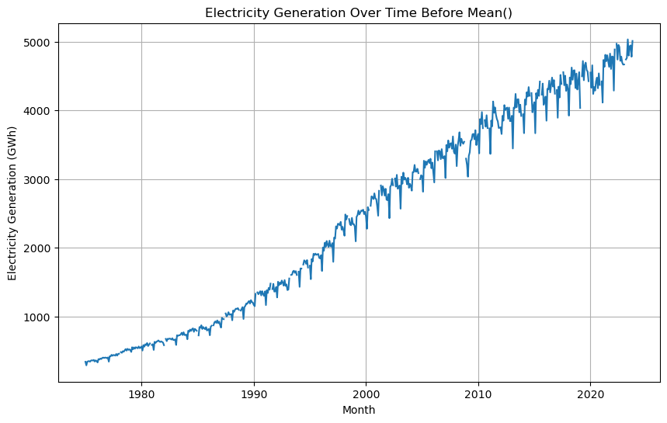
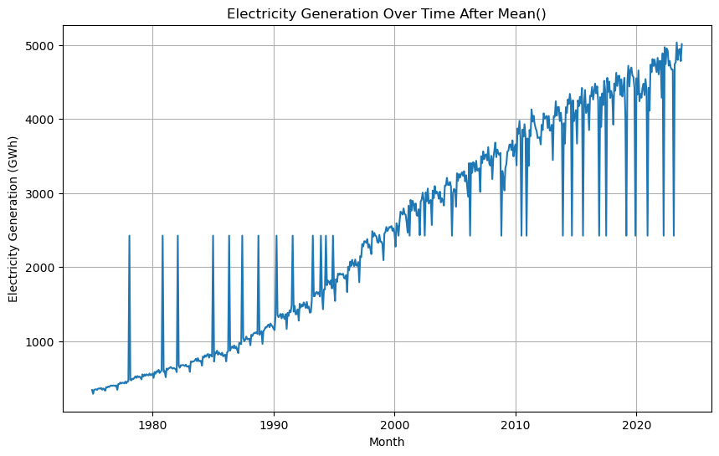
Electricity generation dataset
Resolving NaN values using means():
There are several ways to resolve NaN values but how do we choose the correct method?
To show this, I will use means() as an example:
Before using means(), there are missing parts of the graph.
After using means(), we can see that although the missing parts are gone, the trend of the graph is not preserved.

Slide 18

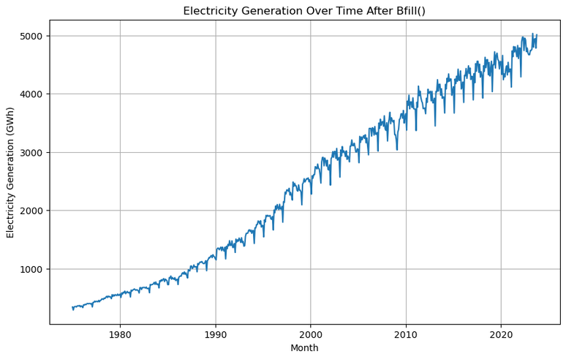
Electricity generation dataset
Resolving NaN values using bfill():
Before using bfill(), there are missing parts of the graph.
After using bfill(), we can see that the missing parts are gone and the trend of the graph is preserved.

Slide 19
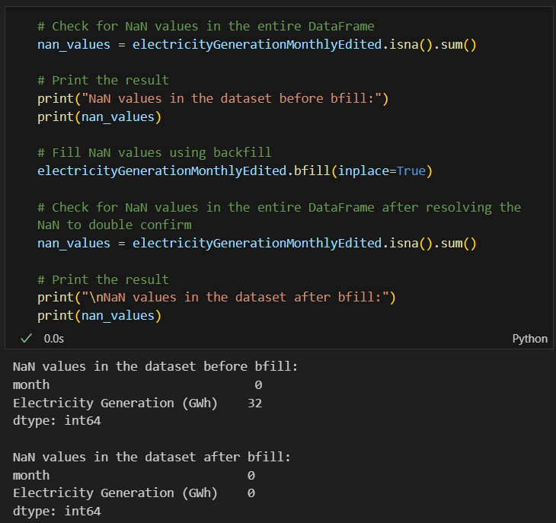
Electricity generation dataset
Hence, I used bfill() to remove the NaN values from the dataset.

Slide 20
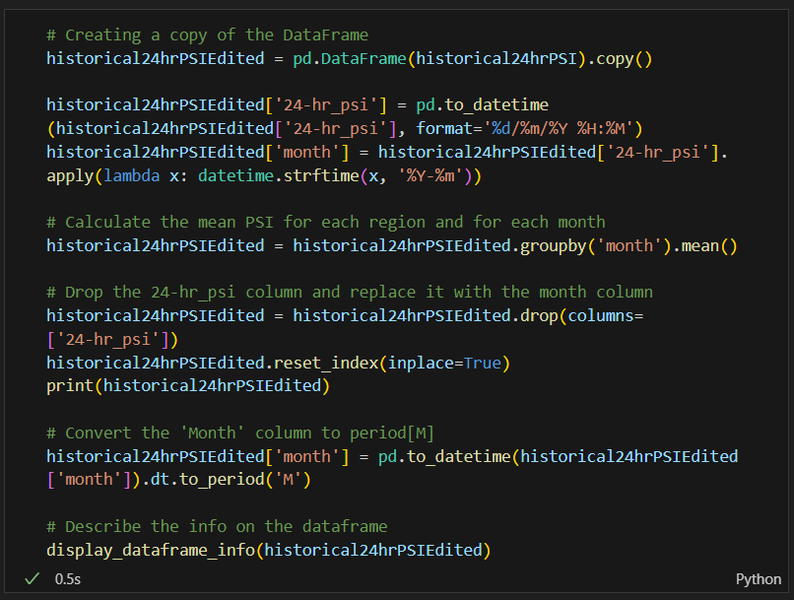
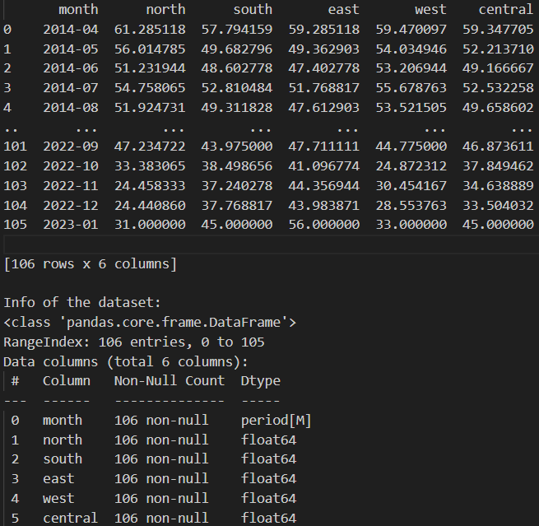
Historical 24hr PSI dataset
Converted the hourly psi_reading into a monthly reading with the desired date format and dtype.

Slide 21
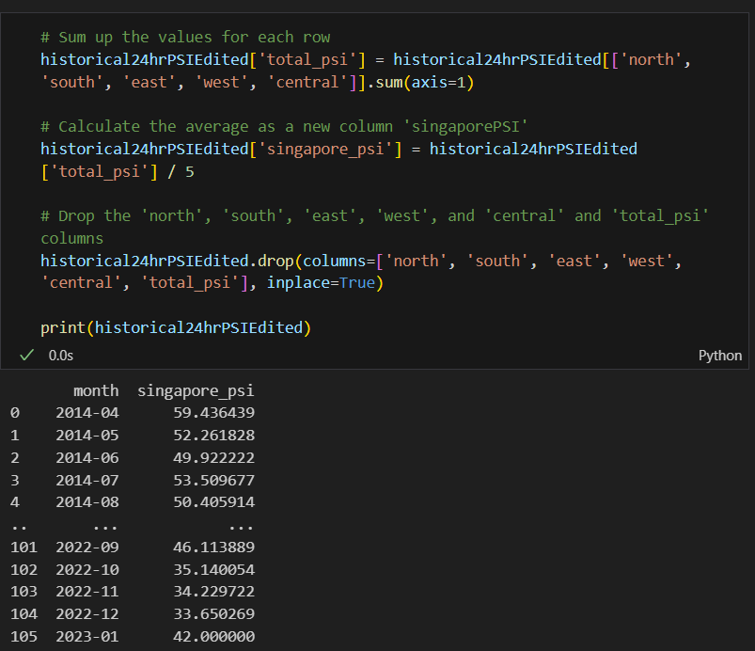
Historical 24hr PSI dataset
Found the average PSI from the total of the 5 regions in Singapore. This is what we need as it is a general representative of the PSI across all of Singapore.

Slide 22
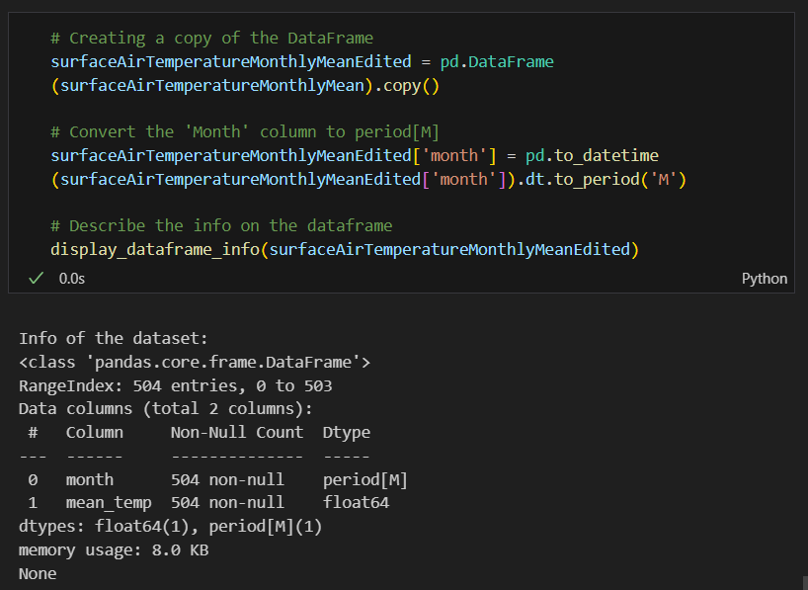
Surface Air Temperature Monthly Mean dataset
Converted the months column into the desired dtype.

Slide 23
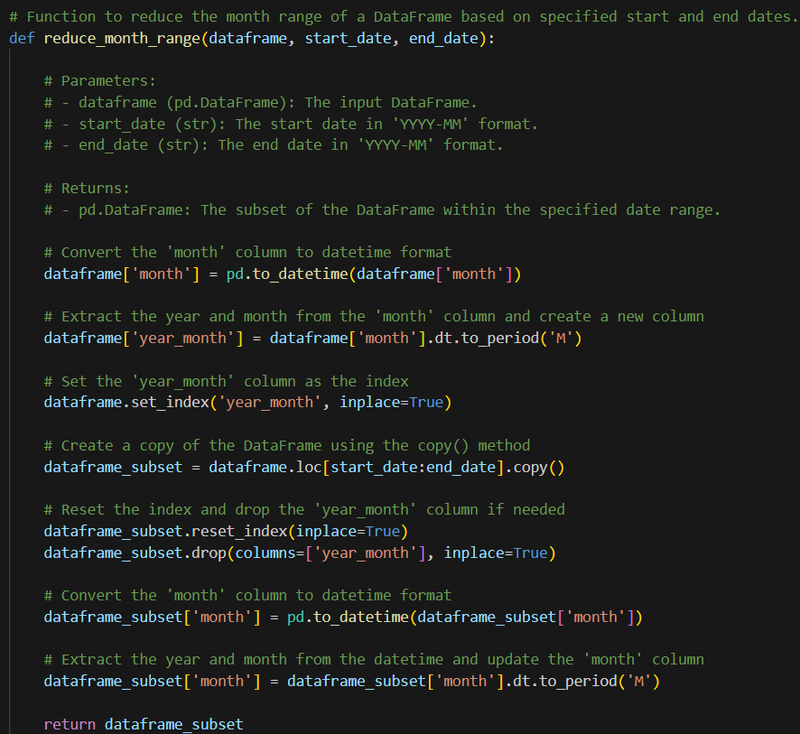
For all datasets
Code used to reduce the timeframe:
The original datasets all have data range that do not match each other. Hence the need to subset and ensure the time is similar.

Slide 24
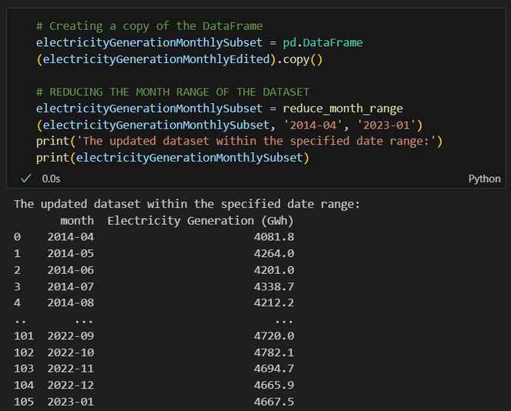
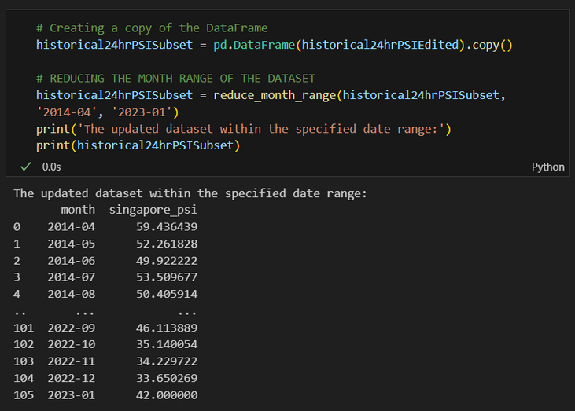
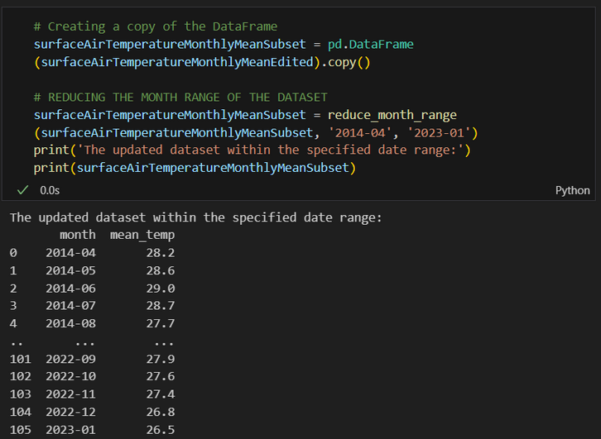
For all datasets
Electricity Generation dataset:
Historical 24hr PSI dataset:
Electricity Generation dataset:

Slide 25
VISUALIZATION
AFTER TRANSFORM
3 datasets in total

Slide 26
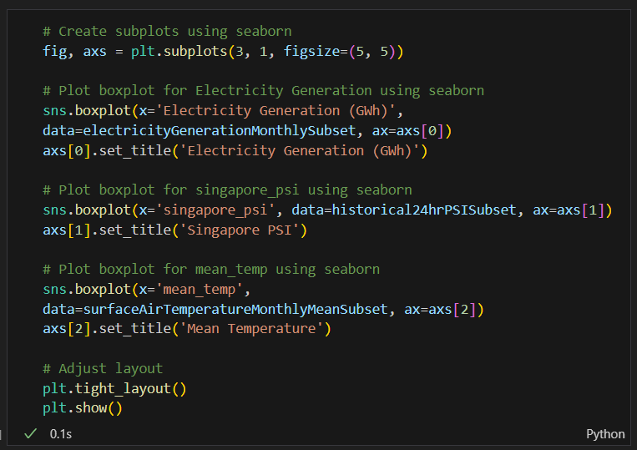
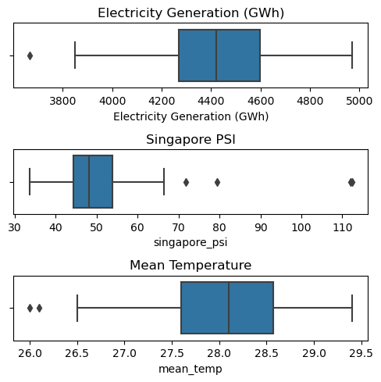
Visualizing the datasets
From visualizing the data in a boxplot, we are able to see the Q1 and Q3, the IQR and the outliers of each dataset.

Slide 27
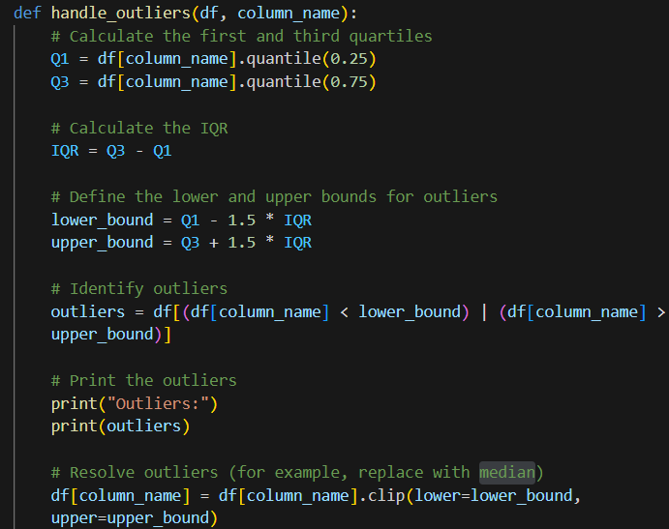
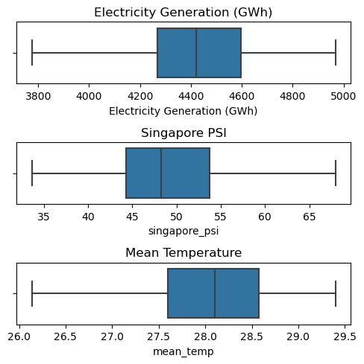
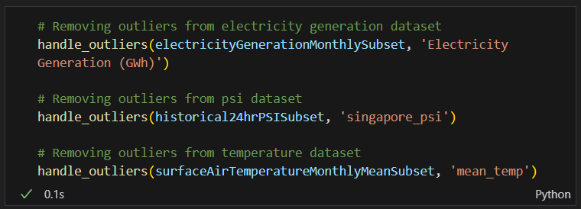
Resolving outliers
Function used to resolve outliers:
Visualizing after resolving outliers:

Slide 28
REGRESSION ANALYSIS
TOTAL OF 3 DATASETS

Slide 29
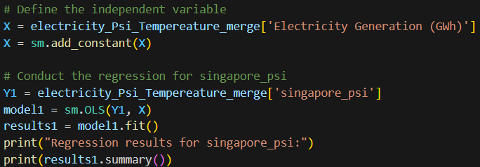
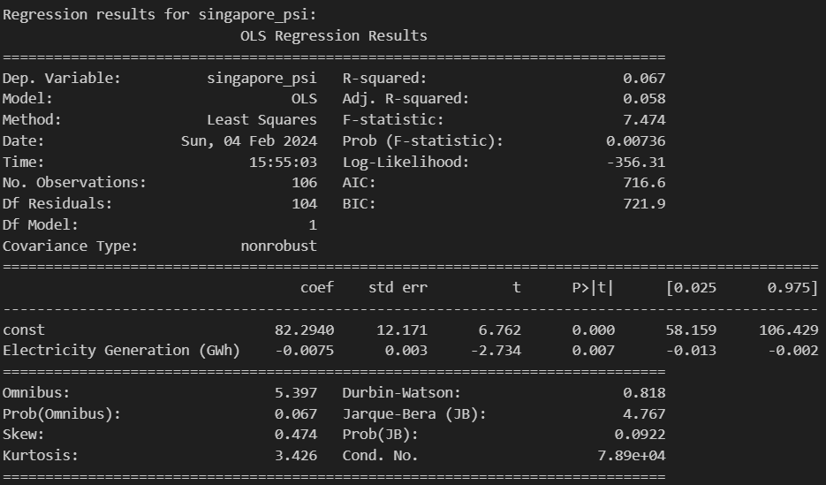
Regression analysis of psi
R-squared value: The value is 0.067 which means it is a good fit.
Coefficient: The value is -0.0075 which means the 2 variables are inversely proportional to each other.
Std error: The value is 0.003 which means that the standard error is low and accuracy is high.
P >|t|: The value is 0.007 which means that the it is significant.
In summary, this model explains about 6.7% of the variance in `singapore_psi` and suggests that `Electricity Generation (GWh)` significantly predicts `singapore_psi`.

Slide 30
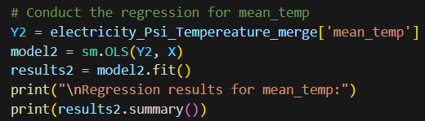
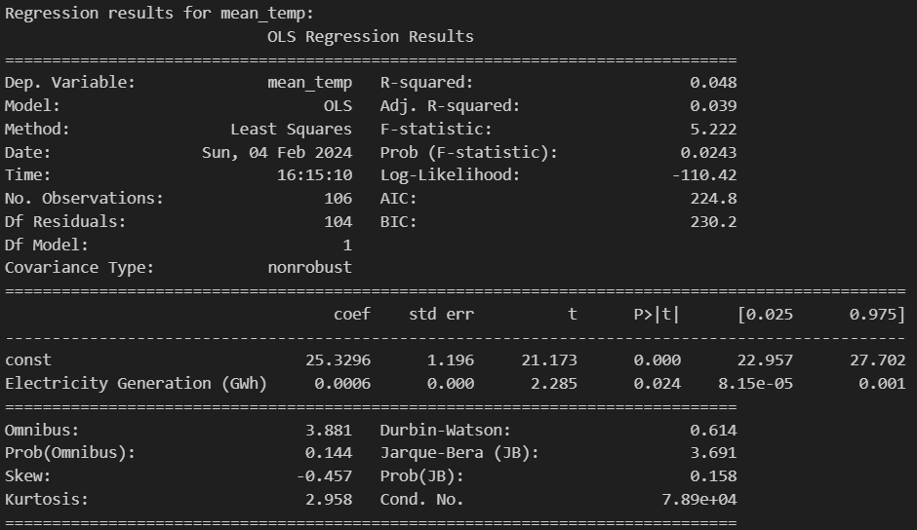
Regression analysis of temperature
R-squared value: The value is 0.048which means it is not that good of a fit.
Coefficient: The value is 0.0006 which means the 2 variables are inversely proportional to each other.
Std error: The value is 0 which means that the standard error is low and accuracy is high.
P >|t|: The value is 0.024 which means that the it is significant.
In summary, this model explains about 4.8% of the variance in `singapore_psi` and suggests that `Electricity Generation (GWh)` significantly predicts `singapore_psi`.

Slide 31
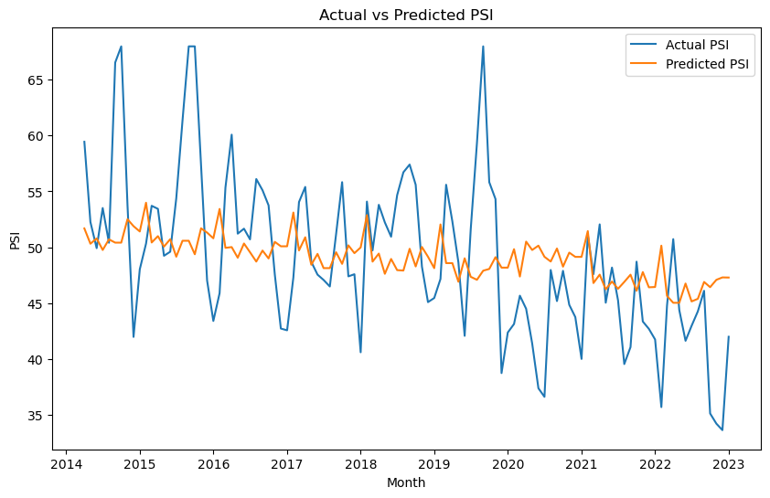
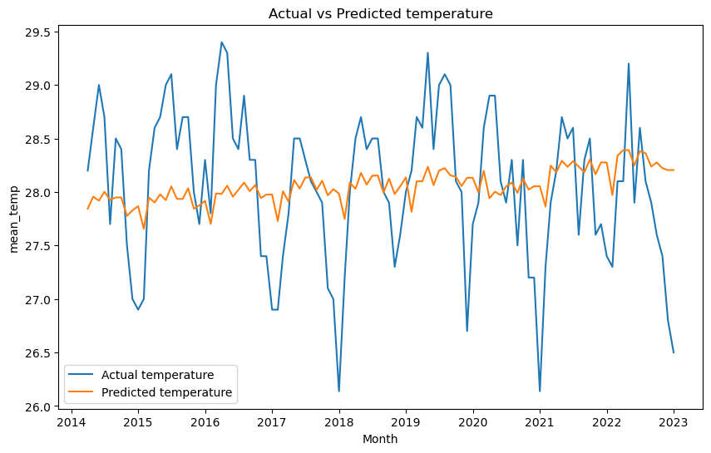
Prediction and insights
These are the predictions after conducting regression analysis and fitting the model to random values of electrical generation in the future.
We can see that the regression model we have done is not a good indicator of future environmental impacts. It could be because electricity generation is not the only contributing factor to environmental imapcts.
This might be also because some of the reasons stated in the next slide.

Slide 32
Conclusion
In conclusion, the correlation between electricity generation and prevailing environmental impacts might be present but it also can vary based on multiple factors,
renewable energy
Renewable energy such as solar energy might not have a large impact on the environment yet it is included in the total amount of electricity generated
air pollution (PSI)
PSI might not only be caused by electricity generation alone, but can be from other sources as well such as personal vehicles on the road.
climate change such as temperature
Other countries might have a larger impact on climate change than Singapore as Singapore is such as small country.

Slide 33


THANK YOU

Slide 34
Dataset information:
Background Information of the datasets:
- Electricity generation dataset:
- Theme: Impact on the environment
- Subject: Energy and environment
- Topic: Energy generation/consumption
- Table title: Electricity generation, monthly
- Data range: 1975-01 to 2023-10
- Source: https://tablebuilder.singstat.gov.sg/table/TS/M890831
- Historical 24-hr PSI dataset:
- Theme: Environment
- Subject: Environment and pollution
- Topic: Air pollution/24-hr PSI
- Table title: Historical24hrPSI
- Data range: 2014-04 to 2023-01
- Source: https://beta.data.gov.sg/collections/1380/view
- Surface Air Temperature Monthly Mean dataset:
- Theme: Environment
- Subject: Environment and climate change
- Topic: Surface Temperature
- Table title: SurfaceAirTemperatureMonthlyMean
- Data range: 1982-01 to 2023-12
- Source: https://beta.data.gov.sg/collections/1419/view

